Slide 1
Group A
Vsh
GR log Hussain
Neutron density log Rashed/Valentine
Porosity Soroosh
Porosity Correction Hamed
Sw
Pickett plot Peerachat
Archie Equation (Clean Sand Model) Miguel
Notes:
Hussain

Slide 2
Reservoir identification
Volume of shale, porosity
Notes:
Hussain

Slide 3
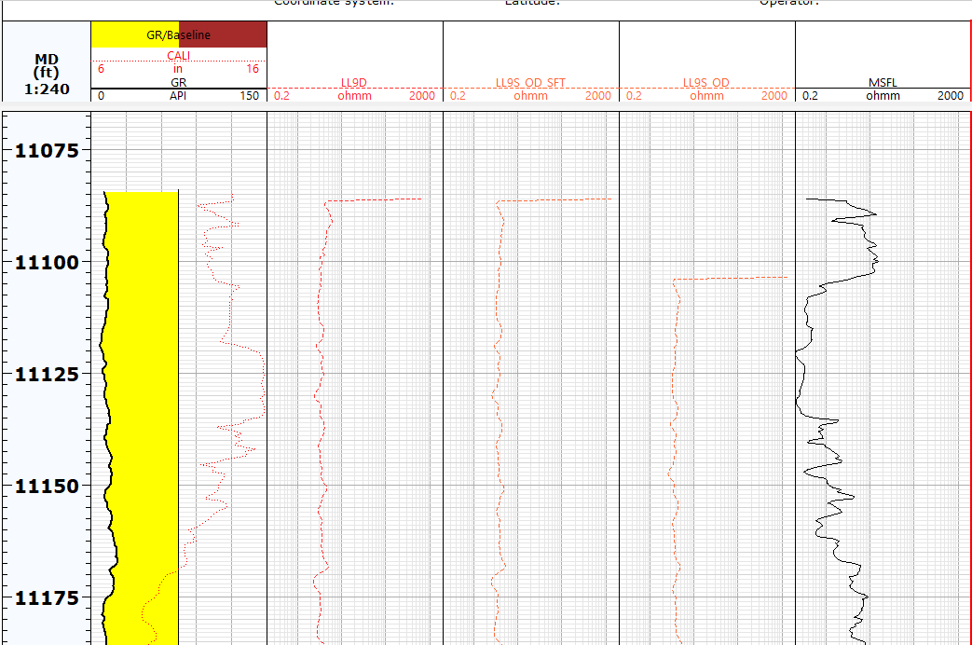

Slide 4

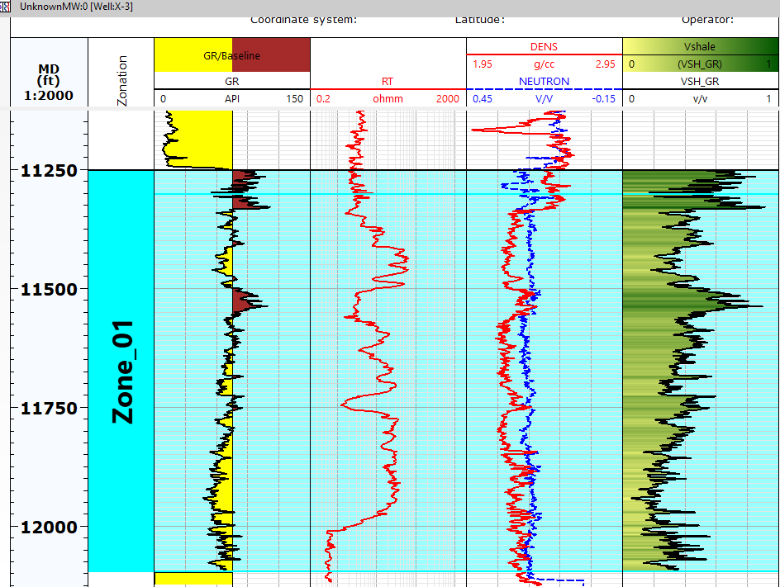
Volume of Shale Calculation – Gamma Ray log
Selected the zonation window to be the zone of interest (11252 and 12096 ft)
define the GR_shale (max) and GR_matrix (min) cut-offs for our calculations
Notes:
Hussain

Slide 6
Volume of Shale Calculation - Neutron density log
Notes:
Rashed and Valentine

Slide 7
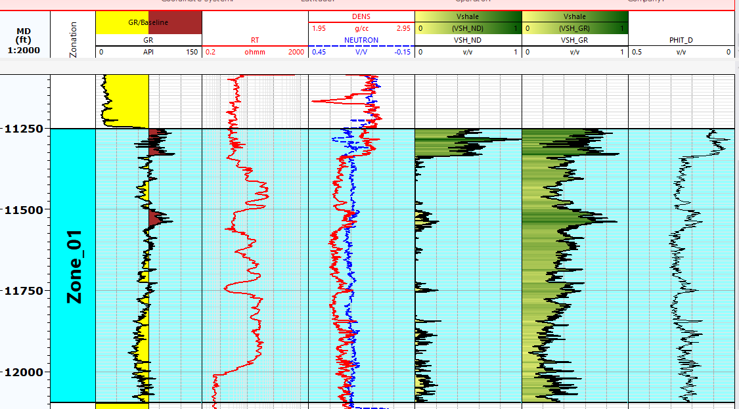
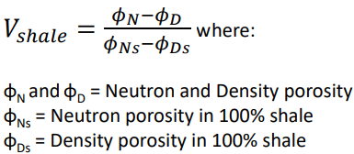
Notes:
Rashed and Valentine

Slide 8
Reservoir identification
Porosity

Slide 9
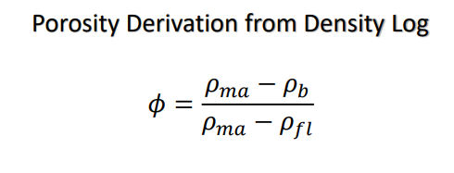
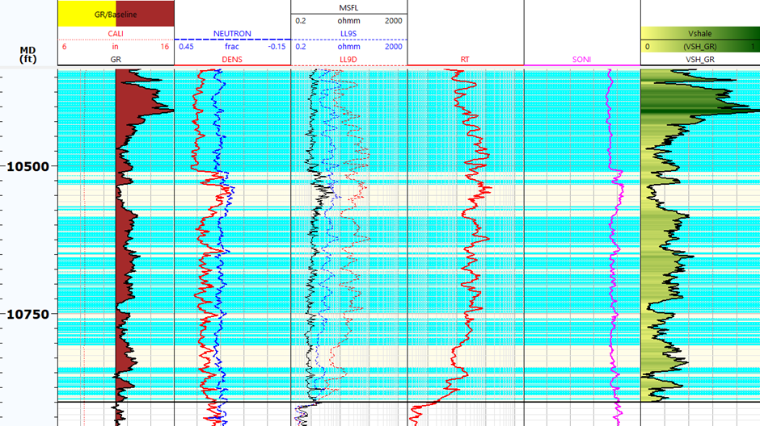

Slide 10
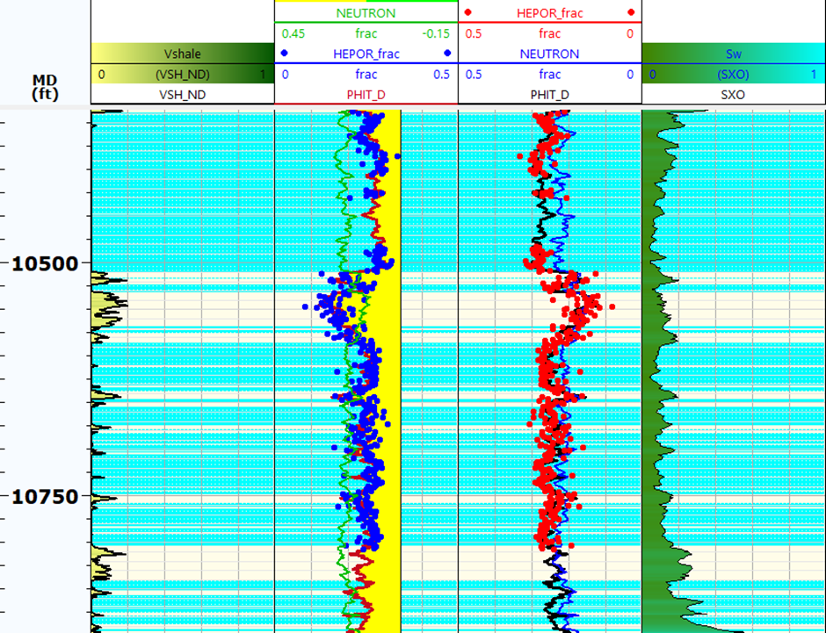

Slide 11
Fluid identification Water saturation calculation:
Pickett plot, Archie, Waxman-Smit

Slide 12
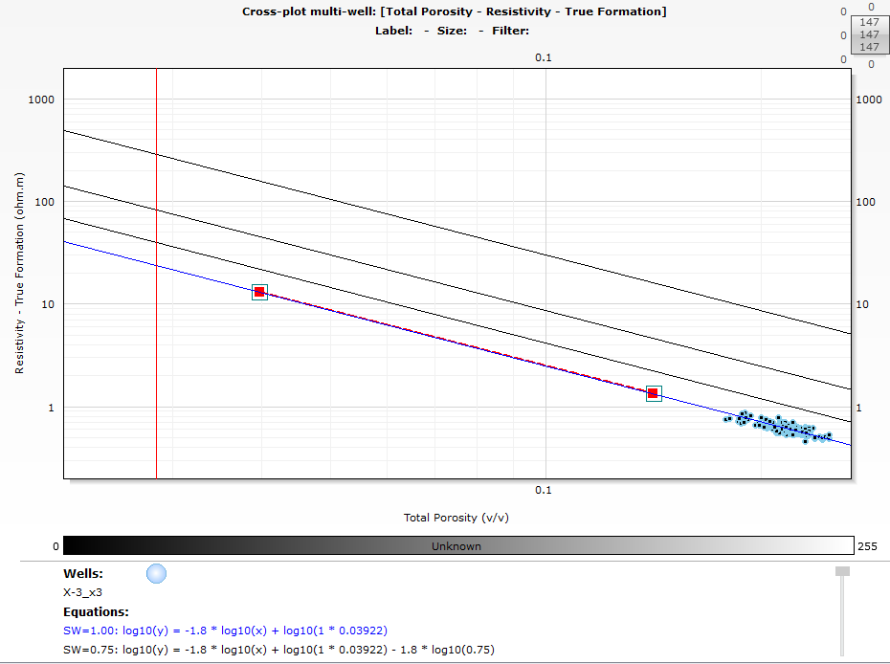
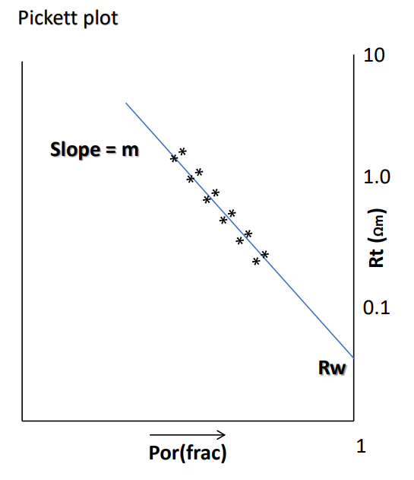
Sw^{-n} = (R_{t}/R_{w})*𝜙^{m}

Slide 13
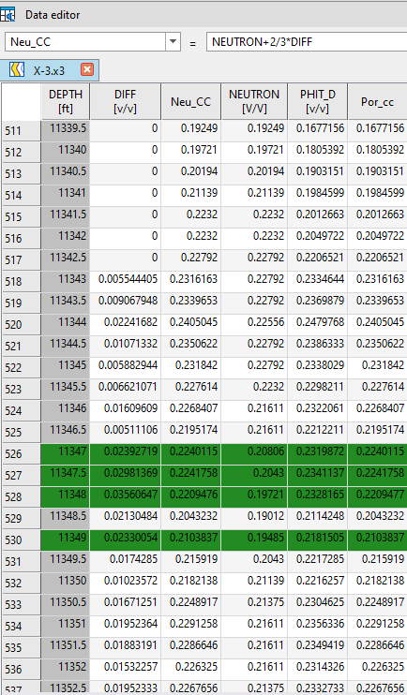

Slide 14
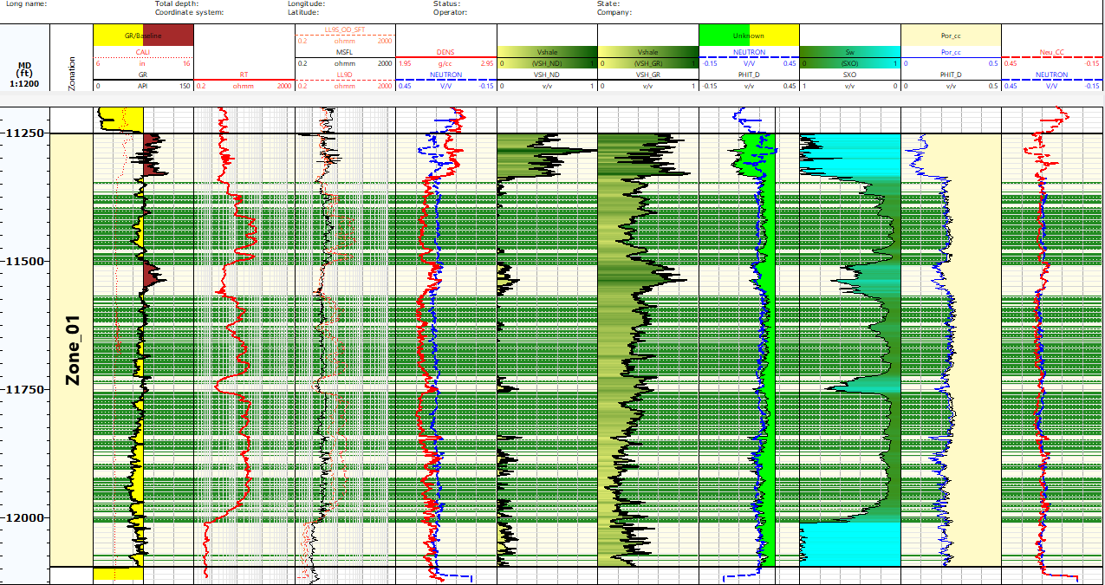

Slide 15
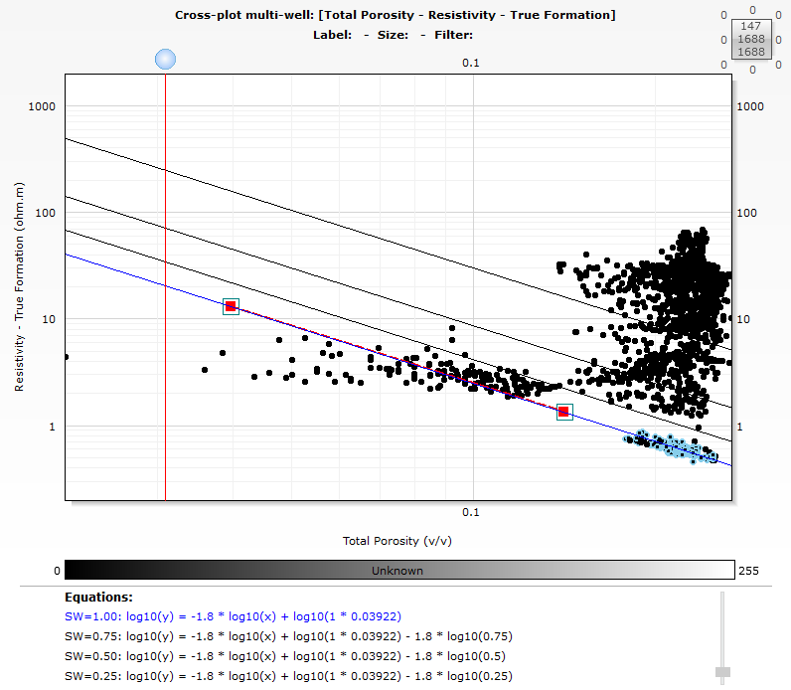
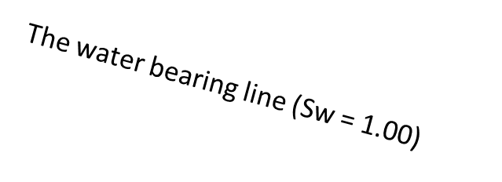
Archie equation
Sw^{-n} = (1/a)(R_{t}/R_{w})*𝜙^{m}
a = Tortuosity factor (assumed = 1.0 in clean formation)
m = Cementation exponent (1.8)
n = Saturation exponent (1.8)
φ = Porosity Density/Neutron log
Rt = True formation resistivity (Ωm) Uninvaded Zone (Deep Resistivity Log)
Rw = Formation water resistivity (Ωm) Produced water analysis

Slide 16
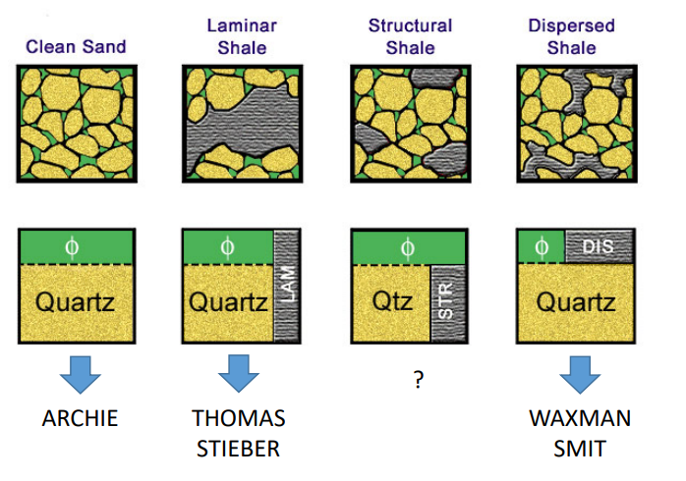
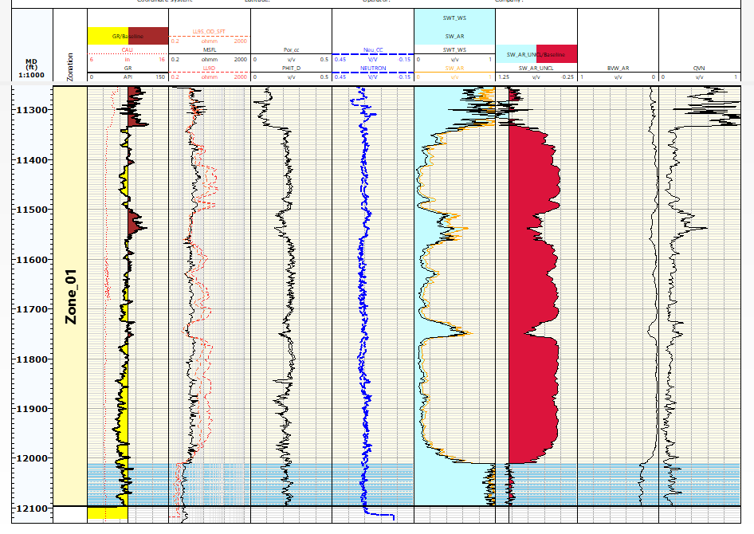
Advantages of Pickett plot
Water saturation can be predicted without prior knowledge of Rw
Limitation of Pickett Plot
Pickett plot is its inability to handle shaly formation

Slide 17
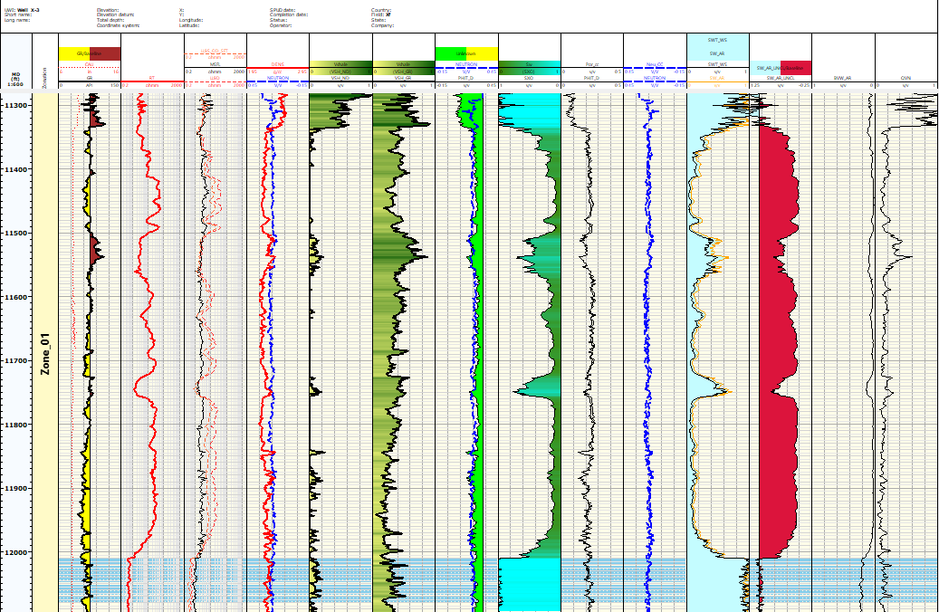

Slide 18
